Slide 1
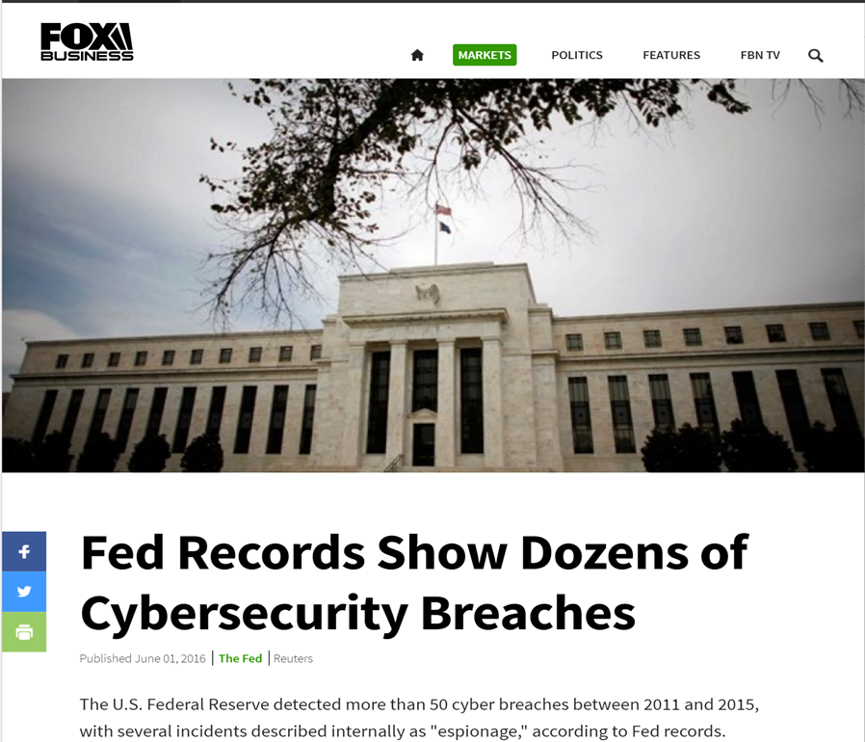
Cybersecurity in the News - 2016

Slide 2
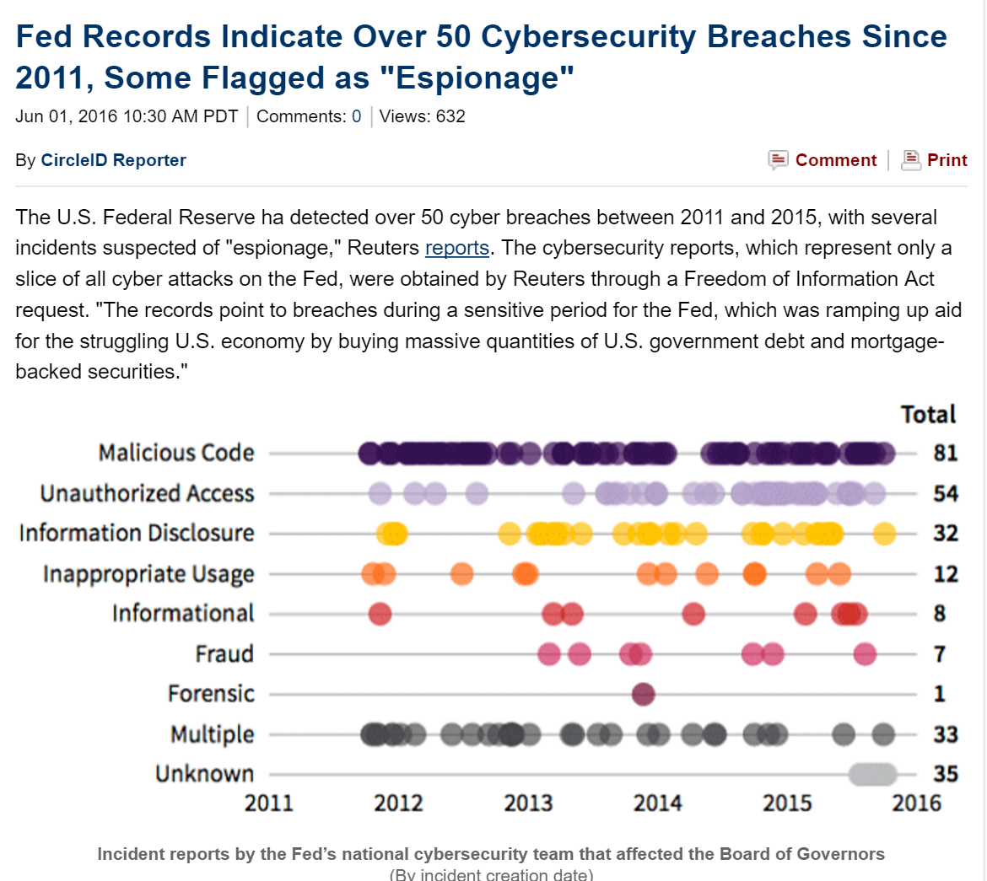
Cybersecurity in the News - 2016

Slide 3
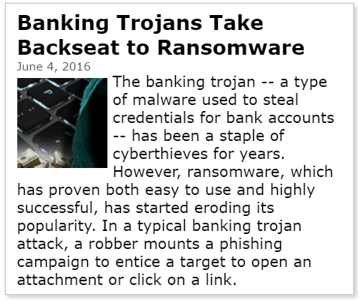
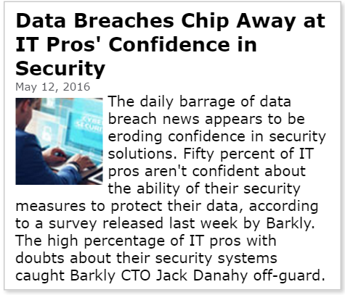
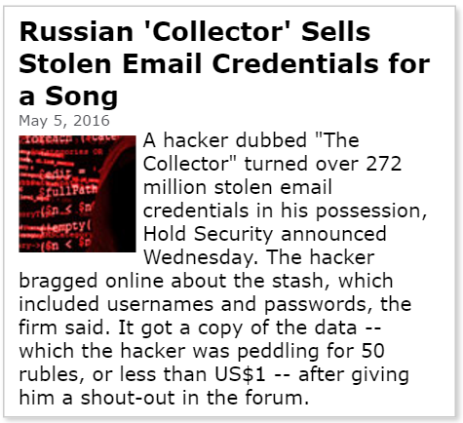
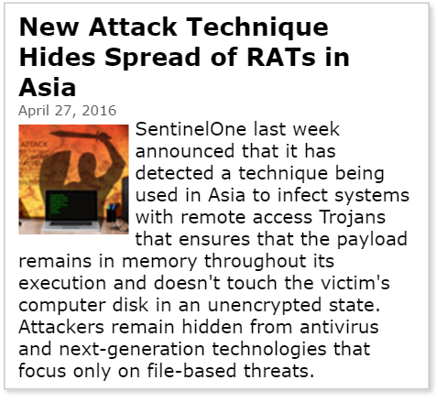
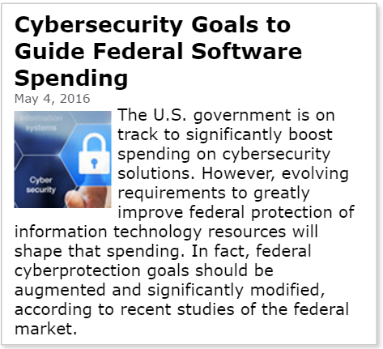
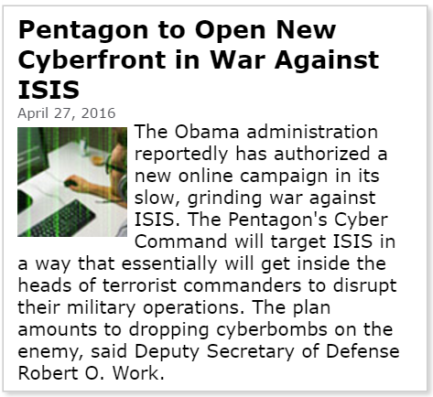
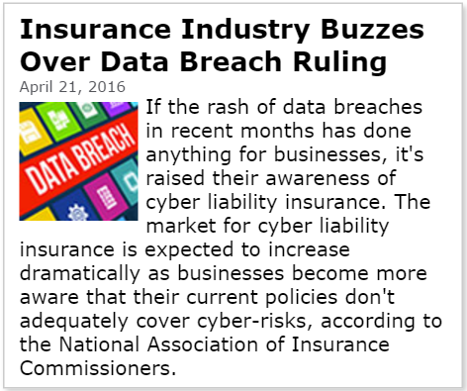
Cybersecurity in the News - 2016

Slide 4
Data Center– Traditional Approaches
MANAGEMENT
VMWare Tools
SDN/MICROSEGMENTATION
VM Ware NSX
Cisco ACI
ORCHESTRATION
Nuage Networks
Notes:
Traditional Approaches
Inhibited by Throughput Restrictions at Top of Rack 100 GB/sec
North/South Detection doesn’t fit E/W Behavior which is Different
Doesn’t Get Granular to the Process Level

Slide 5
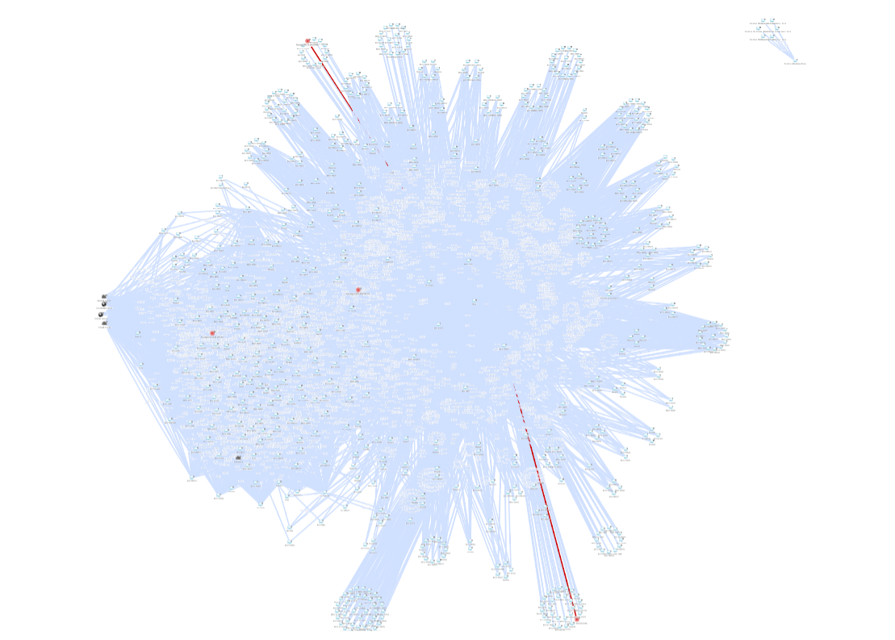

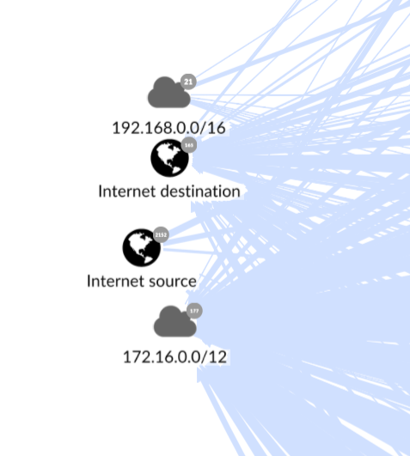
This Is a Data Center
This is the Data Center Perimeter

Slide 6



This Is a Data Center
Here most of the security is placed

Slide 7
This Is a Data Center
?
Most of the traffic is a blind spot

Slide 8

This Is a Data Center
When Attackers get in…
?

Slide 9



This Is a Data Center
?
…they are free to move

Slide 10
Data Center – East – West/ Lateral Movement – Unprotected & Lack of Visibility
Currently the most important portion of our infrastructure the Data Center is highly vulnerable:
Lateral attacks meet very little resistance and occur under near zero visibility
Damage occurs immediately
Attacker dwell time is averaging 13+ months
Often TLS Encrypted
Notes:
Currently the most important portion of our infrastructure is highly vulnerable.
Lateral attacks meet very little resistance and occur under near zero visibility.
Damage occurs immediately .
Attacker dwell time is averaging 13+ months.

Slide 11
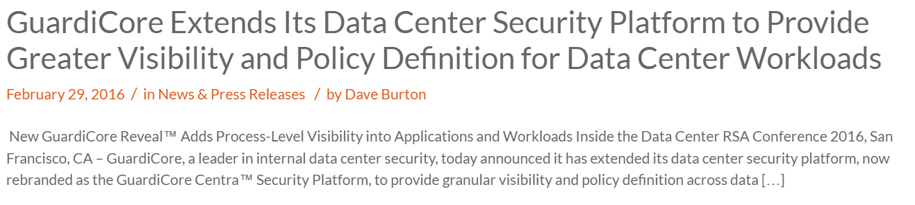
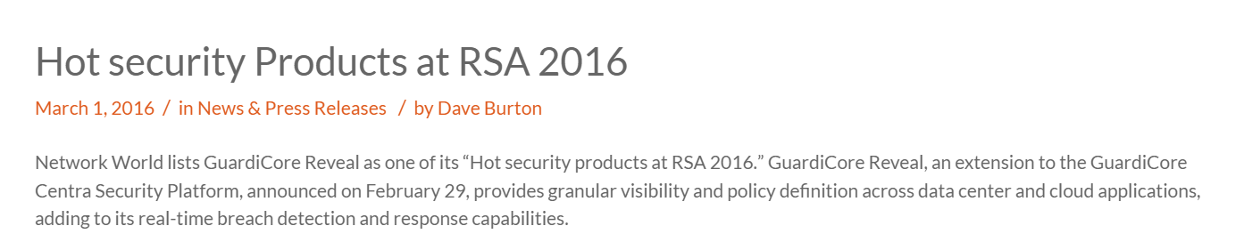
News & Press

Slide 12
Data Center – Leverage Your Existing Investments
Netflow, S-Flow
RestAPI
CEF, Syslog
STIX
Integration
Partners/APIs
Integration
Partners/APIs
MANAGEMENT
VMWare Tools
SDN/MICROSEGMENTATION
VM Ware NSX
Cisco ACI
ORCHESTRATION
Nuage Networks

Slide 13








Supported Environments
VMware – ESXi (>5.1), NSX-V
OpenStack/KVM (OVS, Nuage Networks)
CloudStack/XenServer (NSX-MH)
Cisco ACI
Bare Metal
Docker
AWS, Azure
Hybrid
Hyper-V

Slide 14

^{Thank you}
^{CONFIDENTIAL AND PROPRIETARY}

